Slide 1
Student Name
DEVA.R
3rd year B.E.CSE
NM ID :au421221104010
Email ID:rdeva2624@gmail.com
3/21/2024 Annual Review

Slide 2
PROJECT TITLE Crop disease detection
3/21/2024 Annual Review

Slide 3


AGENDA
Problem Statement
Project Overview
Who Are The End Users?
Your Solution And Its ValueProposition
The Wow In Your Solution
Modelling
Results
3/21/2024 Annual Review

Slide 4

PROBLEM STATEMENT
The problem statement for crop disease detection involves developing robust AI models capable of accurately identifying and diagnosing disease in various crops in using image processing techniques .
This models need to be scalable ,efficient,and adaptable to different environmental conditions to aid farmers in timely disease management and maximize crop yield
3/21/2024 Annual Review

Slide 5

PROJECT OVERVIEW
The problem statement for crop disease detection involves developing robust AI models capable of accurately identifying and diagnosing diseases in various crops using image processing techniques. These models need to be scalable, efficient, and adaptable to different environmental conditions to aid farmers in timely disease management and maximize crop yield.
3/21/2024 Annual Review

Slide 6

WHO ARE THE END USERS?
The end users of crop disease detection systems are primarily farmers, agricultural extension workers,
who are responsible for monitoring and managing crop health in agricultural fields
These individuals rely on accurate and timely information about crop diseases to make informed decisions regarding pest control, disease management system
3/21/2024 Annual Review

Slide 7

YOUR SOLUTION AND ITS VALUE PROPOSITION
Our solution uses AI for accurate crop disease detection, offering early identification, high accuracy, efficiency, cost-effectiveness, and improved yields for farmers.
Through proactive disease management ,our soution contributes to higher crop yields and improved agricultural productivity enhancing food security and livelihoods for farmers
3/21/2024 Annual Review

Slide 8

THE WOW IN YOUR SOLUTION
Our crop disease detection solution harnesses cutting-edge AI algorithms to swiftly identify and diagnose plant illnesses, revolutionizing agricultural practices with its accuracy and efficiency.
3/21/2024 Annual Review

Slide 9
MODELLING
Crop disease detection modeling involves using machine learning and computer vision techniques to develop algorithms that can identify diseases in crops based on images.
This typically involves collecting a dataset of images of healthy and diseased crops, labeling them accordingly, and then training a model, often a convolutional neural network (CNN), to classify them. The model learns to distinguish between healthy and diseased crops based on patterns and features in the images
3/21/2024 Annual Review

Slide 10
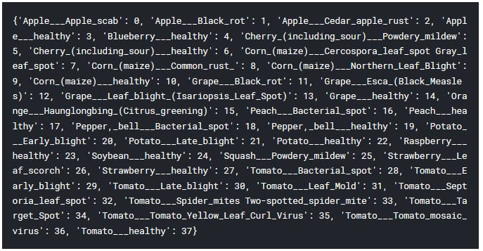
RESULTS
Demo Link
3/21/2024 Annual Review

